Slide 1
Flight delay predictions
Mid-term Project I
Patrick Wong
April 9, 2021
Notes:
Hi everyone, my topic here today is flight delay predictions.

Slide 2
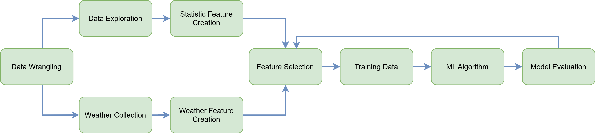
process
Notes:
For this project, we followed this simple process. We began with data wrangling where we pulled a subset of the original database in order to do some exploratory data analysis.
After the EDA, we moved on to feature selection creating our machine learning algorithm models. After feeding our model our data, we did a model evaluation, and if we weren’t satisfied, we went back to the drawing board with our feature selection.

Slide 3
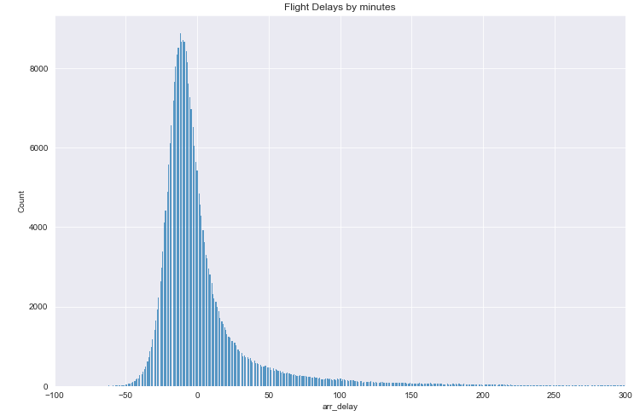
Data exploration
Notes:
Many of the different parameters in the dataset were looked into. First thing we looked at was the count of arrival delays. The data set may look normally distributed, but you can see that it is skewed to the right.

Slide 4
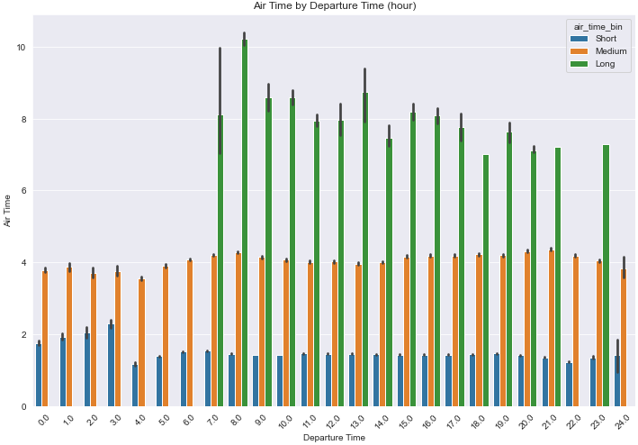
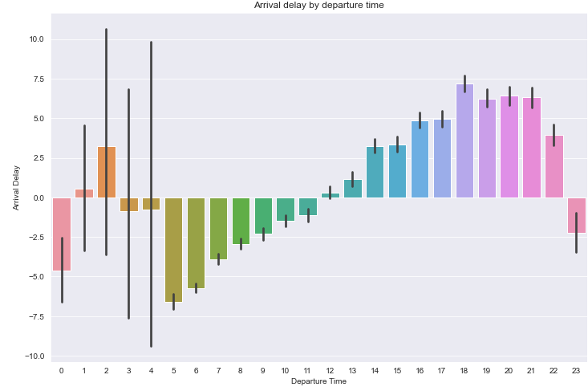
Data exploration
Notes:
Another variable that was looked into was the departure time. In these two plots, we can see that a lot of the longer flights leave later during the day, and related to that, we can also see that the arrival delay for flights that depart later in the day have a higher mean value. So it is safe to assume that longer flights have a higher chance of being delayed.

Slide 5
Weather api
Used the World Weather Online historical API wrapper.
Made calls for weather information easy
Outputted weather information for day’s average
Notes:
For the weather information, I was able to pull data using the world weather online API wrapper, which made getting information easier.

Slide 6
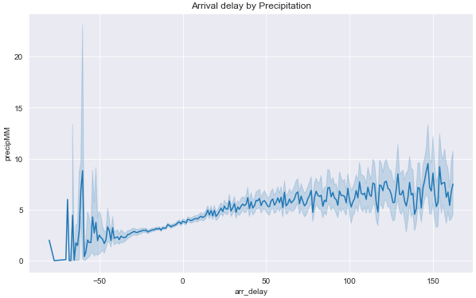
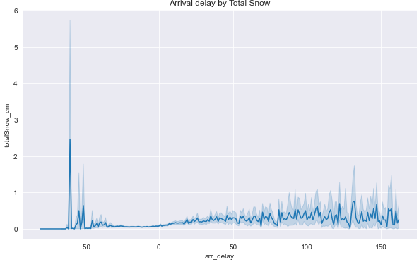
Weather
Notes:
Looking at the weather information, I was able to plot the precipitation and total snow against the arrival delays.
While it makes sense that there would be an increase in arrival delay as there is more precipitation, I was a little surprised at how little snowfall affected the delay. One reason could be that there is a threshold for snowfall, and once it passes that threshold the flight could be cancelled entirely.

Slide 7
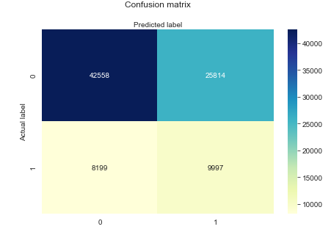
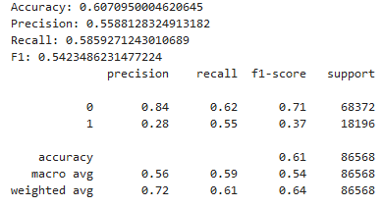
Models – classifer
Ran many different models, including XGB, Logistic Regression
Delay: > 10 minutes
Best results came from the logistic regression model.
Oversampling by using SMOTE
Notes:
I began by doing a classification model to predict whether or not there was an actual delay.
I set the arrival delay threshold to anything over 10 minutes would be considered a delay. I ran a couple of different models, but focused on XGB and logistic regression.
In the end, the best result came from the logistic regression model. For the class imbalance, I used SMOTE for oversampling.

Slide 8

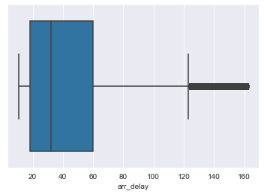
Models – regression
Many different models used, such as Linear, XGB, Random Forest
All models performed similarly with features chosen
Found Random Forest to perform the best
Notes:
As with the classification models, a bunch of different models were tested on the training data set. All of the models performed rather similarly.
While the R squared values I received were low, the mean absolute error value when compared to the mean value of actual delays (meaning any delays over 10 minutes), was less than half of that amount. Ideally I would have liked to lower this amount, but decided to proceed with this model.

Slide 9
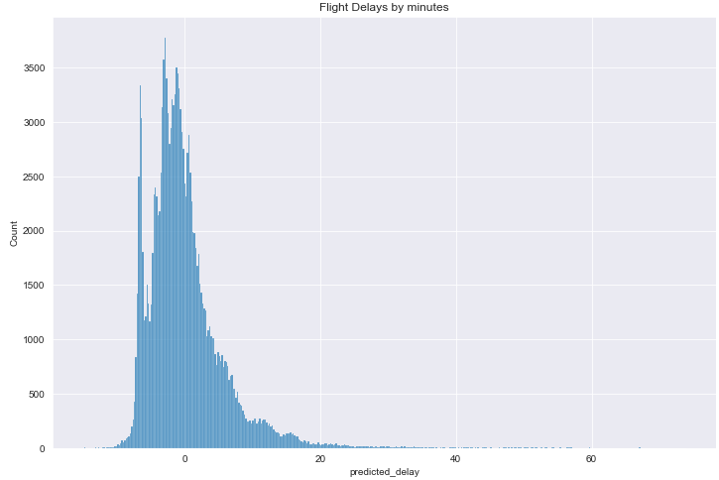
Predictions
Notes:
Using the Random Forest Regressor model, it was used to make a prediction for the first week of January 2020. As you can see, it follows the same shape as the training data, with it being skewed to the right.

Slide 10
Looking ahead
Exploring more feature engineering to improve model accuracy
Make use of more models
Improve code quality
Look into fuel database more
Notes:
Looking ahead, there are lots of areas of improvement that could be done to the model. I would have liked to have done more feature engineering, as evident by the low r squared score I got.
More time would have also allowed me to run more models.
Code quality in my notebooks could be improved
And looking into the fuel database in more detail would have been nice to come to a conclusion on how delays would affect some of the businesses through fuel consumption.

